Slide 1

CYCLIST BIKE SHARE ANALYSIS
- Aswin A

Slide 2
Business Task
Analyze rider's usage patterns for marketing membership conversion programs.
Tools: Microsoft Excel for data cleaning, Tableau for data visualization
Data cleaning and manipulation Using Microsoft excel
Analysing the data
Cleaning the data by removing extra spaces, duplicates
Filling the missing observation or data using Measures of central tendency.
Created new columns to find out the exact duration of the ride, Start and end time, particular day of the ride, falls on weekday or weekend.
Finally bringing unstructured data into structured data
Tableau for data visualization
Created interactive charts to bring insights how the ride are performed as per week, day and duration of the ride.
Findings
Casual customers take the most rides on the weekends. Conversely, our members take the most rides during the week.
Total Casual rider 2,30,692 and Member 3,02,266.
Members have the highest ride usage on weekend.
casual have the highest ride usage on weekday
Recommendation
Target casual customers who rent a bike for leisure on their weekends

Slide 3
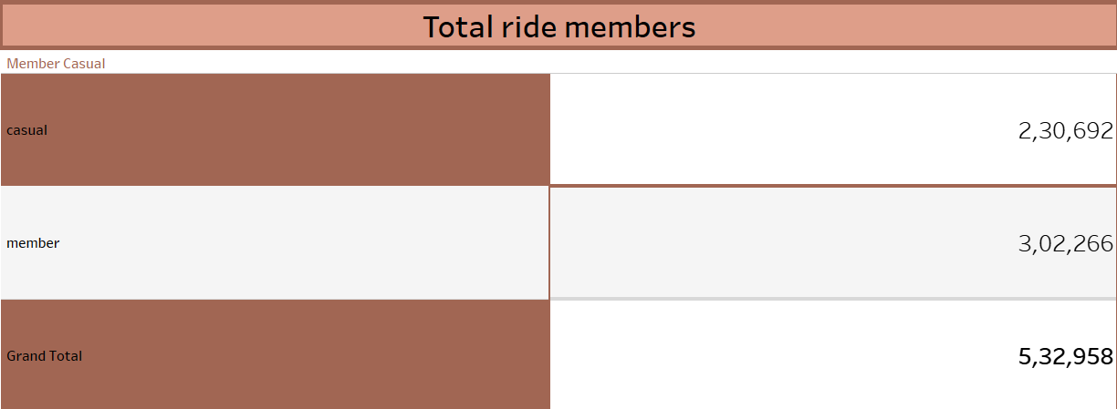

Slide 4
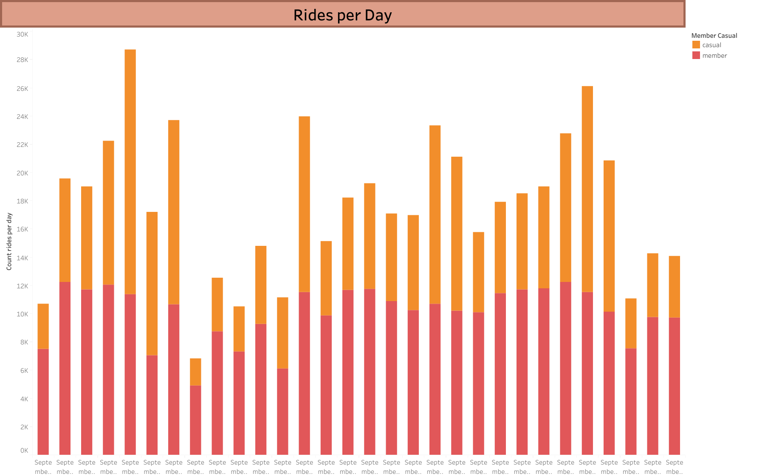

Slide 5
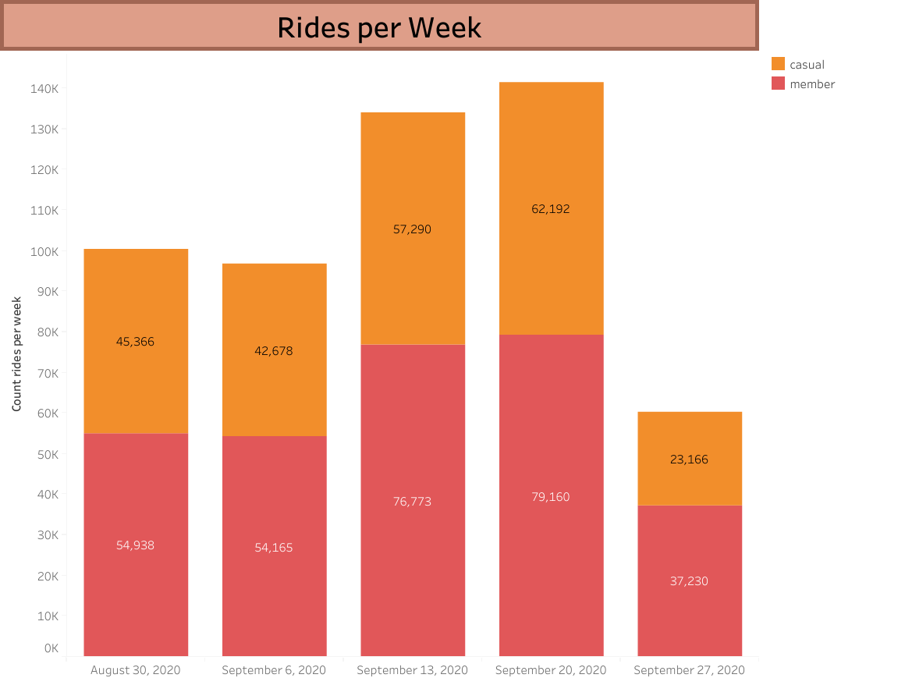

Slide 6
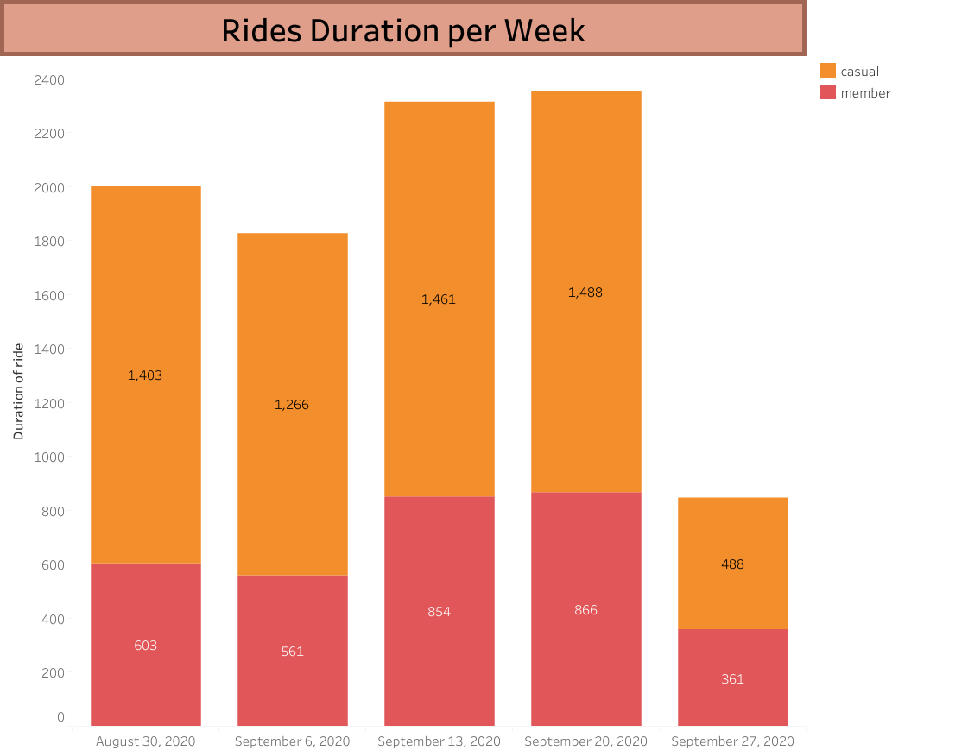

Slide 7
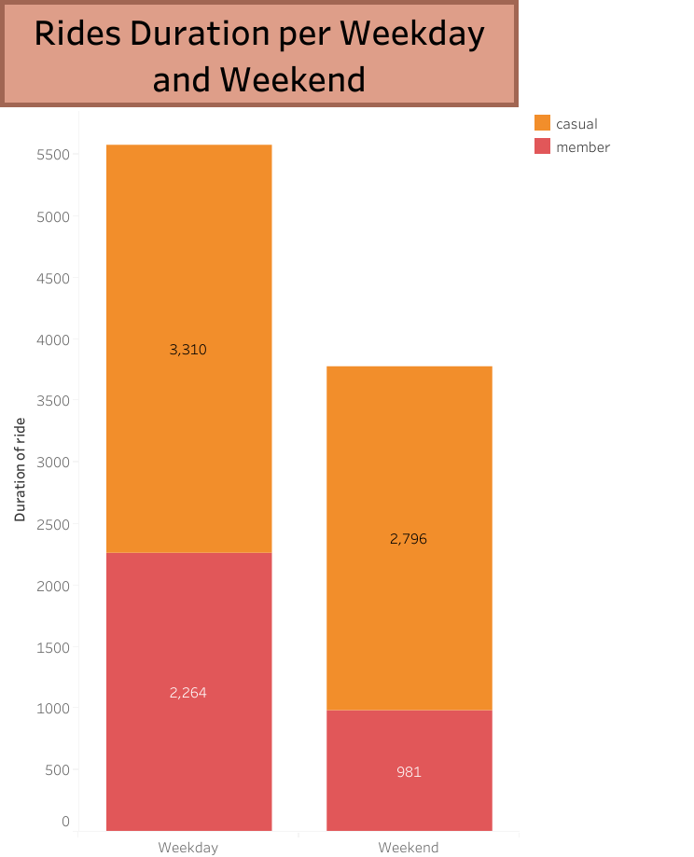

Slide 8
